Slide 1
Chapter 4 – Requirements Engineering
Some of the slides are taken from: Prof. Gregor V. Bochmann’s Software Requirements Analysis Course https://www.site.uottawa.ca/~bochmann/SEG3101/

Slide 2
Topics covered
Introduction to requirements analysis
Functional and non-functional requirements
Requirements engineering processes
IEEE 830 – 1998 SRS

Slide 3
Requirements engineering
The process of establishing the services that a customer requires from a system and the constraints under which it operates and is developed.
The system requirements are the descriptions of the system services and constraints that are generated during the requirements engineering process.

Slide 4
What is a requirement?
It may range from a high-level abstract statement of a service or of a system constraint to a detailed mathematical functional specification.
Requirements may serve a dual function
May be the basis for a bid for a contract.
May be the basis for the contract itself.

Slide 5
Types of requirement
User requirements
Statements in natural language plus diagrams of the services the system provides and its operational constraints.
Written for customers.
System requirements
A structured document setting out detailed descriptions of the system’s functions, services and operational constraints.
Defines what should be implemented so may be part of a contract between client and contractor.

Slide 6
Mentcare
Mentcare is a medical information system that maintains information about patients suffering from mental health problems and the treatments that they have received.
It makes use of a centralized database of patient information but has also been designed to run on a PC.
It may be accessed and used from sites that do not have secure network connectivity.
When the local systems have secure network access, they use patient information in the database but they can download and use local copies of patient records when they are disconnected.

Slide 7
Mentcare goals
To generate management information that allows health service managers to assess performance against local and government targets.
To provide medical staff with timely information to support the treatment of patients.
4/1/2019

Slide 8
The organization of the Mentcare system
4/1/2019

Slide 9
User and system requirements

Slide 10
Readers of different types of requirements specification

Slide 11
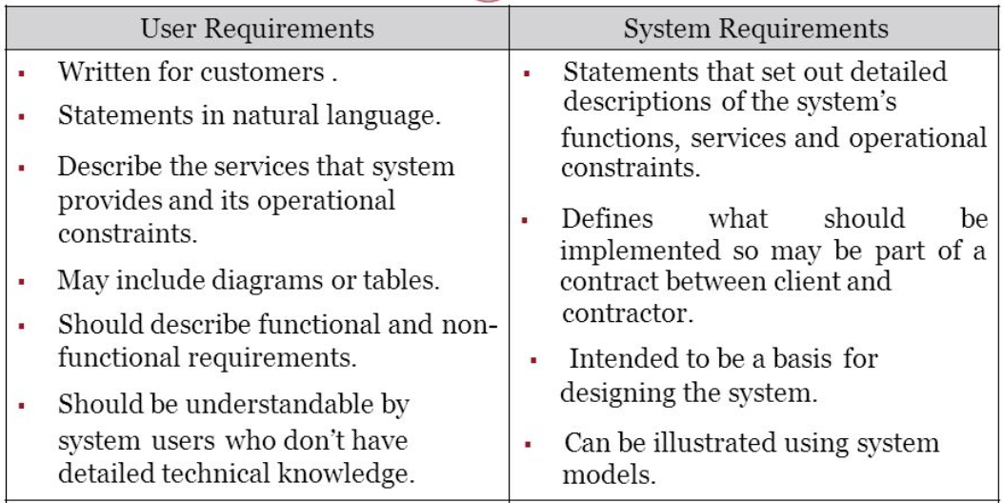
User requirements vs. System requirements

Slide 12
System stakeholders
Any person or organization who is affected by the system in some way and so who has a legitimate interest
Stakeholder types
End users
System managers
System owners
External stakeholders

Slide 13
Stakeholders in the Mentcare system
Patients whose information is recorded in the system.
Doctors who are responsible for assessing and treating patients.
Nurses who coordinate the consultations with doctors and administer some treatments.
Medical receptionists who manage patients’ appointments.
IT staff who are responsible for installing and maintaining the system.

Slide 14
Stakeholders in the Mentcare system
A medical ethics manager
Ensure that the system meets current ethical guidelines for patient care.
Health care managers
Obtain management information from the system.
Medical records staff
Responsible for ensuring that system information can be maintained and preserved, and that record keeping procedures have been properly implemented.

Slide 15
Functional and non-functional requirements

Slide 16
Functional and non-functional requirements
Functional requirements
Statements of services the system should provide, how the system should react to particular inputs and how the system should behave in particular situations.
May state what the system should not do.
Non-functional requirements
Constraints on the services or functions offered by the system such as timing constraints, constraints on the development process, standards, etc.
Often apply to the system as a whole rather than individual features or services.
Domain requirements
Domain reflects the environment in which the system operates so.
Constraints on the system from the domain of operation.

Slide 17
Functional requirements
Describe functionality or system services.
Depend on the type of software, expected users and the type of system where the software is used.
Functional user requirements may be high-level statements of what the system should do.
Functional system requirements should describe the system services in detail.

Slide 18
Mentcare system: examples of functional requirements
A user shall be able to search the appointments lists for all clinics.
The system shall generate each day, for each clinic, a list of patients who are expected to attend appointments that day.
Each staff member using the system shall be uniquely identified by his or her 8-digit employee number.

Slide 19
Non-functional requirements
These define system properties and constraints e.g. reliability, response time and storage requirements. Constraints are I/O device capability, system representations, etc.
Process requirements may also be specified mandating a particular IDE, programming language or development method.
Non-functional requirements may be more critical than functional requirements. If these are not met, the system may be useless.

Slide 20
Types of nonfunctional requirement

Slide 21
Non-functional classifications
Product requirements
Requirements which specify that the delivered product must behave in a particular way e.g. execution speed, reliability, etc.
Organisational requirements
Requirements which are a consequence of organisational policies and procedures e.g. process standards used, implementation requirements, etc.
External requirements
Requirements which arise from factors which are external to the system and its development process e.g. interoperability requirements, legislative requirements, etc.

Slide 22
Examples of nonfunctional requirements in the Mentcare system
Product requirement The Mentcare system shall be available to all clinics during normal working hours (Mon–Fri, 0830–17.30). Downtime within normal working hours shall not exceed five seconds in any one day. Organizational requirement Users of the Mentcare system shall authenticate themselves using their health authority identity card. External requirement The system shall implement patient privacy provisions as set out in HStan-03-2006-priv.

Slide 23
Usability requirements
The system should be easy to use by medical staff and should be organized in such a way that user errors are minimized. (Goal)
Medical staff shall be able to use all the system functions after four hours of training. After this training, the average number of errors made by experienced users shall not exceed two per hour of system use. (Testable non-functional requirement)

Slide 24
Metrics for specifying nonfunctional requirements
Property | Measure
Speed | Processed transactions/second User/event response time Screen refresh time
Size | Mbytes Number of ROM chips
Ease of use | Training time Number of help frames
Reliability | Mean time to failure Probability of unavailability Rate of failure occurrence Availability
Robustness | Time to restart after failure Percentage of events causing failure Probability of data corruption on failure
Portability | Percentage of target dependent statements Number of target systems

Slide 25
Requirements engineering processes

Slide 26
Requirements engineering processes
The processes used for RE vary widely depending on the application domain, the people involved and the organisation developing the requirements.
However, there are a number of generic activities common to all processes
Requirements elicitation;
Requirements analysis;
Requirements validation;
Requirements management.
In practice, RE is an iterative activity in which these processes are interleaved.

Slide 27
A spiral view of the requirements engineering process

Slide 28
Requirements elicitation

Slide 29
Requirements elicitation and analysis
Sometimes called requirements elicitation or requirements discovery.
Involves technical staff working with customers to find out about the application domain, the services that the system should provide and the system’s operational constraints.
May involve end-users, managers, engineers involved in maintenance, domain experts, trade unions, etc. These are called stakeholders.

Slide 30
Requirements discovery
The process of gathering information about the required and existing systems and distilling the user and system requirements from this information.
Interaction is with system stakeholders from managers to external regulators.
Systems normally have a range of stakeholders.

Slide 31
Interviewing
Formal or informal interviews with stakeholders are part of most RE processes.
Types of interview
Closed interviews based on pre-determined list of questions
Open interviews where various issues are explored with stakeholders.
Effective interviewing
Be open-minded, avoid pre-conceived ideas about the requirements and are willing to listen to stakeholders.
Prompt the interviewee to get discussions going using a springboard question, a requirements proposal, or by working together on a prototype system.

Slide 32
Interviews in practice
Normally a mix of closed and open-ended interviewing.
Interviews are good for getting an overall understanding of what stakeholders do and how they might interact with the system.
Interviewers need to be open-minded without pre-conceived ideas of what the system should do
You need to prompt the user to talk about the system by suggesting requirements rather than simply asking them what they want.

Slide 33
Problems with interviews
Application specialists may use language to describe their work that isn’t easy for the requirements engineer to understand.
Interviews are not good for understanding domain requirements
Requirements engineers cannot understand specific domain terminology;
Some domain knowledge is so familiar that people find it hard to articulate or think that it isn’t worth articulating.

Slide 34
Stories and scenarios
Scenarios and user stories are real-life examples of how a system can be used.
Stories and scenarios are a description of how a system may be used for a particular task.
Because they are based on a practical situation, stakeholders can relate to them and can comment on their situation with respect to the story.

Slide 35
Scenarios
A structured form of user story
Scenarios should include
A description of the starting situation;
A description of the normal flow of events;
A description of what can go wrong;
Information about other concurrent activities;
A description of the state when the scenario finishes.

Slide 36
Example Scenario
Scenario: ATM banking for the week.
Sally Jones places her bank card into the ATM.
Sally successfully logs into the ATM using her personal identification number.
Sally deposits her weekly paycheck of $350 into her savings account.
Sally pays her phone bill of $75, her electric bill of $145, her cable bill of $55, and her water bill of $85 from her savings account.
Sally attempts to withdraw $100 from her savings account for the weekend but discovers that she has insufficient funds.
Sally withdraws $40 and gets her card back.

Slide 37
Requirements specification

Slide 38
Requirements specification
The process of writing down the user and system requirements in a requirements document.
User requirements have to be understandable by end-users and customers who do not have a technical background.
System requirements are more detailed requirements and may include more technical information.
The requirements may be part of a contract for the system development
It is therefore important that these are as complete as possible.

Slide 39
Ways of writing a system requirements specification
Notation | Description
Natural language | The requirements are written using numbered sentences in natural language. Each sentence should express one requirement.
Structured natural language | The requirements are written in natural language on a standard form or template. Each field provides information about an aspect of the requirement. (e.g. use case specification)
Graphical notations | Graphical models, supplemented by text annotations, are used to define the functional requirements for the system; UML use case and sequence diagrams are commonly used.
Mathematical specifications | These notations are based on mathematical concepts such as finite-state machines or sets. Although these unambiguous specifications can reduce the ambiguity in a requirements document, most customers don’t understand a formal specification. They cannot check that it represents what they want and are reluctant to accept it as a system contract.

Slide 40
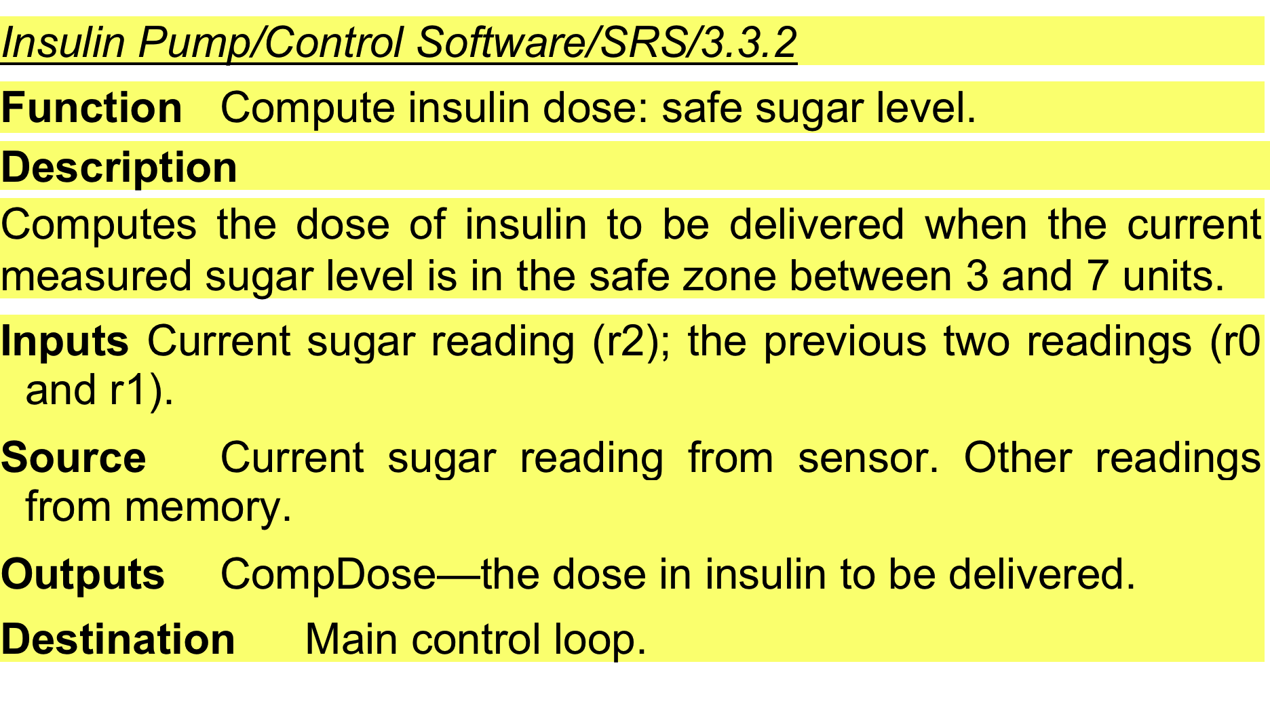
A structured specification of a requirement for an insulin pump

Slide 41
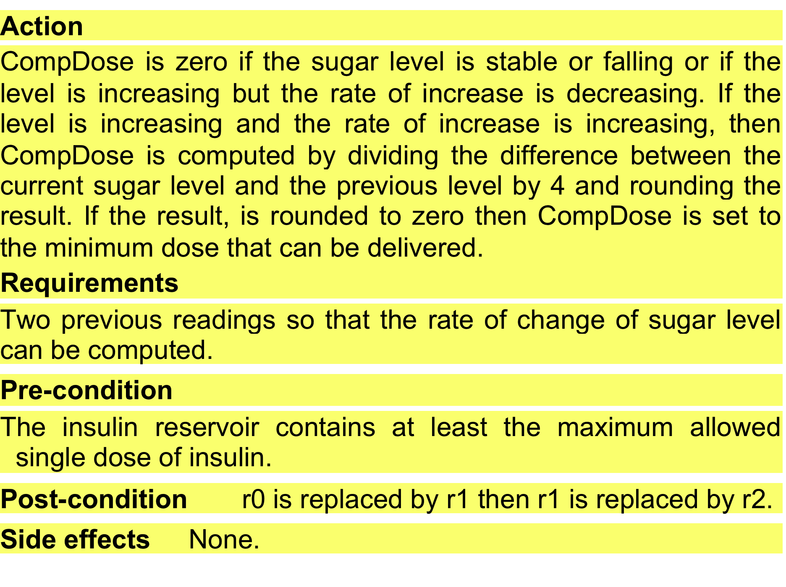
A structured specification of a requirement for an insulin pump

Slide 42
Use cases
Use-cases are a kind of scenario that are included in the UML.
Use cases identify the actors in an interaction and which describe the interaction itself.
A set of use cases should describe all possible interactions with the system.
High-level graphical model supplemented by more detailed tabular description.
UML sequence diagrams may be used to add detail to use-cases by showing the sequence of event processing in the system.

Slide 43
Use cases for the Mentcare system

Slide 44
The software requirements document
The software requirements document is the official statement of what is required of the system developers.
Should include both a definition of user requirements and a specification of the system requirements.
It is NOT a design document. As far as possible, it should set of WHAT the system should do rather than HOW it should do it.

Slide 45
Users of a requirements document

Slide 46
Requirements validation

Slide 47
Requirements validation
Concerned with demonstrating that the requirements define the system that the customer really wants.
Requirements error costs are high so validation is very important
Fixing a requirements error after delivery may cost up to 100 times the cost of fixing an implementation error.

Slide 48
Requirements validation techniques
Requirements reviews
Systematic manual analysis of the requirements.
Prototyping
Using an executable model of the system to check requirements.
Test-case generation
Developing tests for requirements to check testability.

Slide 49
Requirements change

Slide 50
Requirements evolution

Slide 51
Requirements change management
Deciding if a requirements change should be accepted
Problem analysis and change specification
During this stage, the problem or the change proposal is analyzed to check that it is valid. This analysis is fed back to the change requestor who may respond with a more specific requirements change proposal, or decide to withdraw the request.
Change analysis and costing
The effect of the proposed change is assessed using traceability information and general knowledge of the system requirements. Once this analysis is completed, a decision is made whether or not to proceed with the requirements change.
Change implementation
The requirements document and, where necessary, the system design and implementation, are modified. Ideally, the document should be organized so that changes can be easily implemented.

Slide 52
Requirements change management

Slide 53
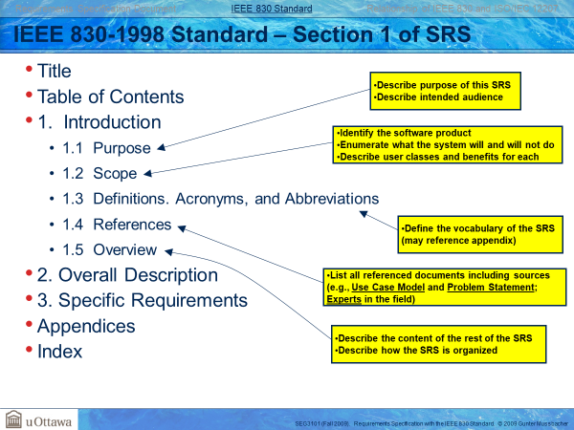

Slide 54
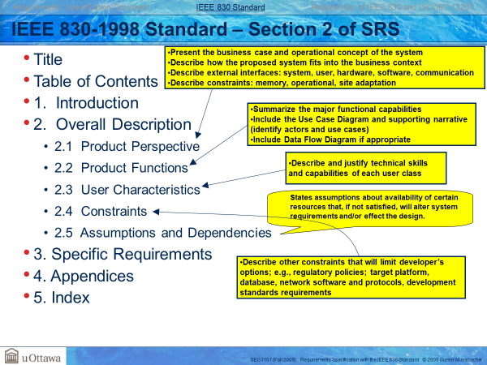

Slide 55
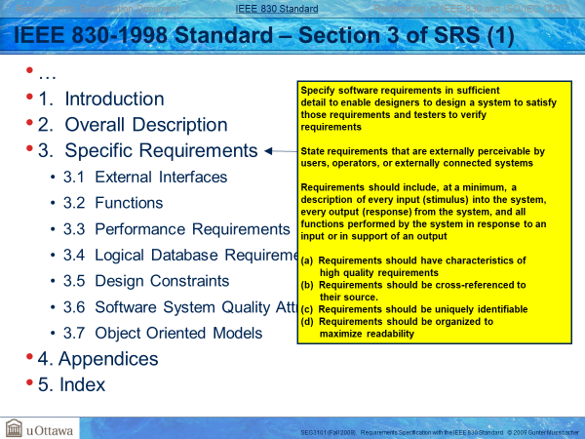

Slide 56
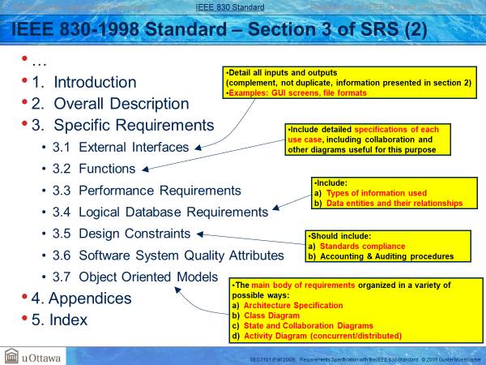

Slide 57
Milestone 1

